Slide 1

Football (Soccer) Manager Firings
Can the News Help us Predict It?

Slide 2
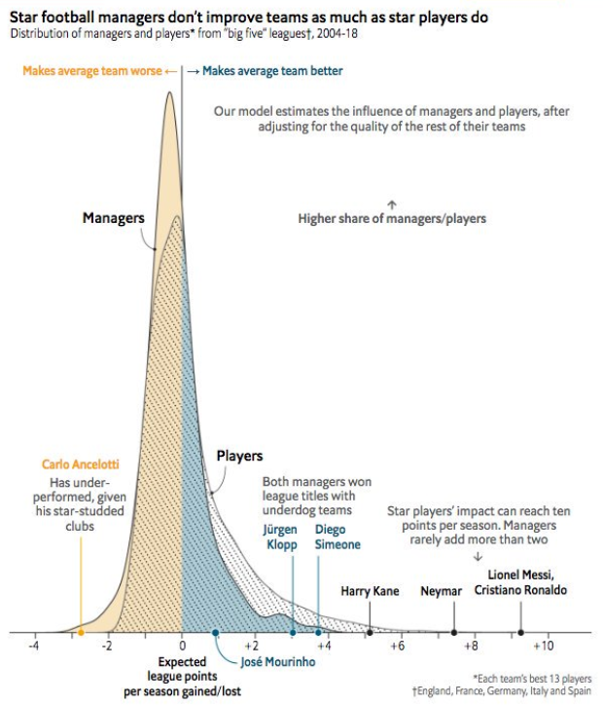
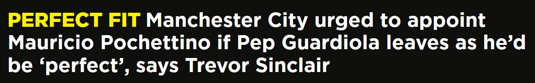

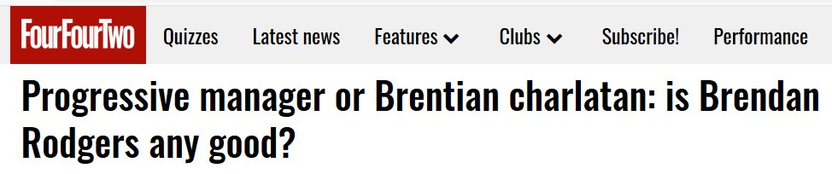
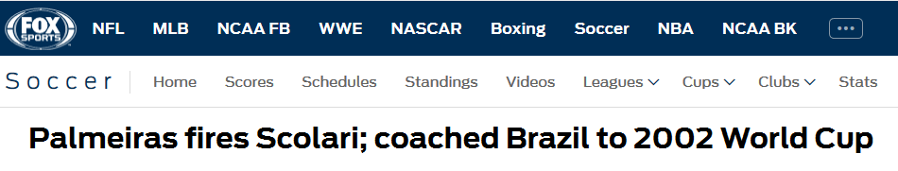
Managers don’t matter
Until they do…

Slide 3

The Question
If they are not that important, why do they have so much press coverage?
Can we predict when football managers will be fired based on the content of news articles?

Slide 4


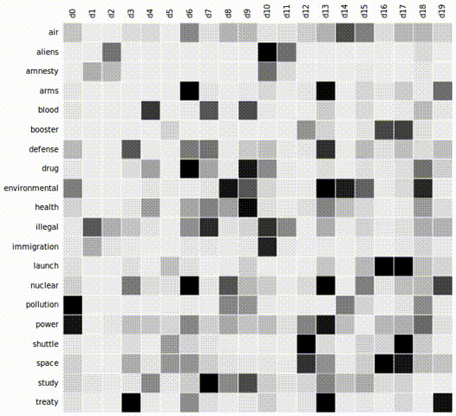


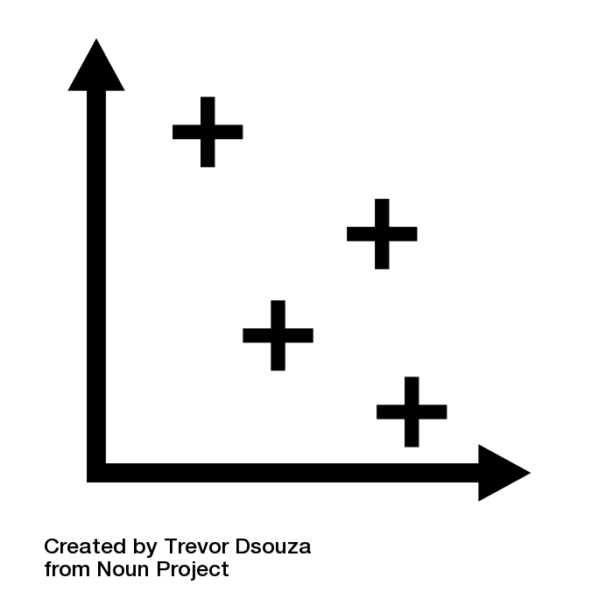
Methodology
Term Frequency–Inverse Document Frequency (TF-IDF)
Collect and Analyse Data
Natural Language Processing (NLP)
Supervised Machine Learning
The Player Kicked the Ball!
Select Models
Manager selection
Lowercase
Web Scraping
Train and Test
Punctuation
Data Cleaning
Stop Words
Lemmatization
Access Results
player; kick; ball

Slide 5

Results
If they are not that impre
Accuracy : 85%
However:
Data was unbalanced (less articles from fired managers) lead to bad prediction for fired managers.
After dealing with the imbalance:
The model got 5 times better at identifying managers who were dismissed!

Slide 6
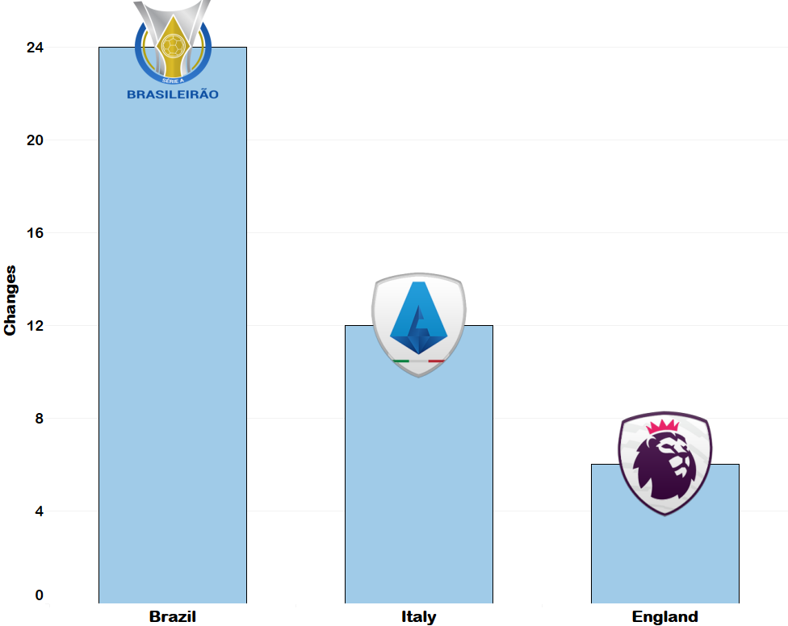
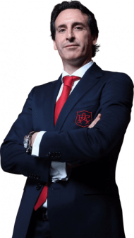
Final Remarks
If they are not that important, why do they have so much press coverage?
Next steps in trying to improve the model :
More data (blogs, columnists, Twitter?)
Adapt and apply the model in a league with higher frequency of manager firings (Brazilian or Italian leagues for example)
Manager Changes – Last Season

